Slide 1
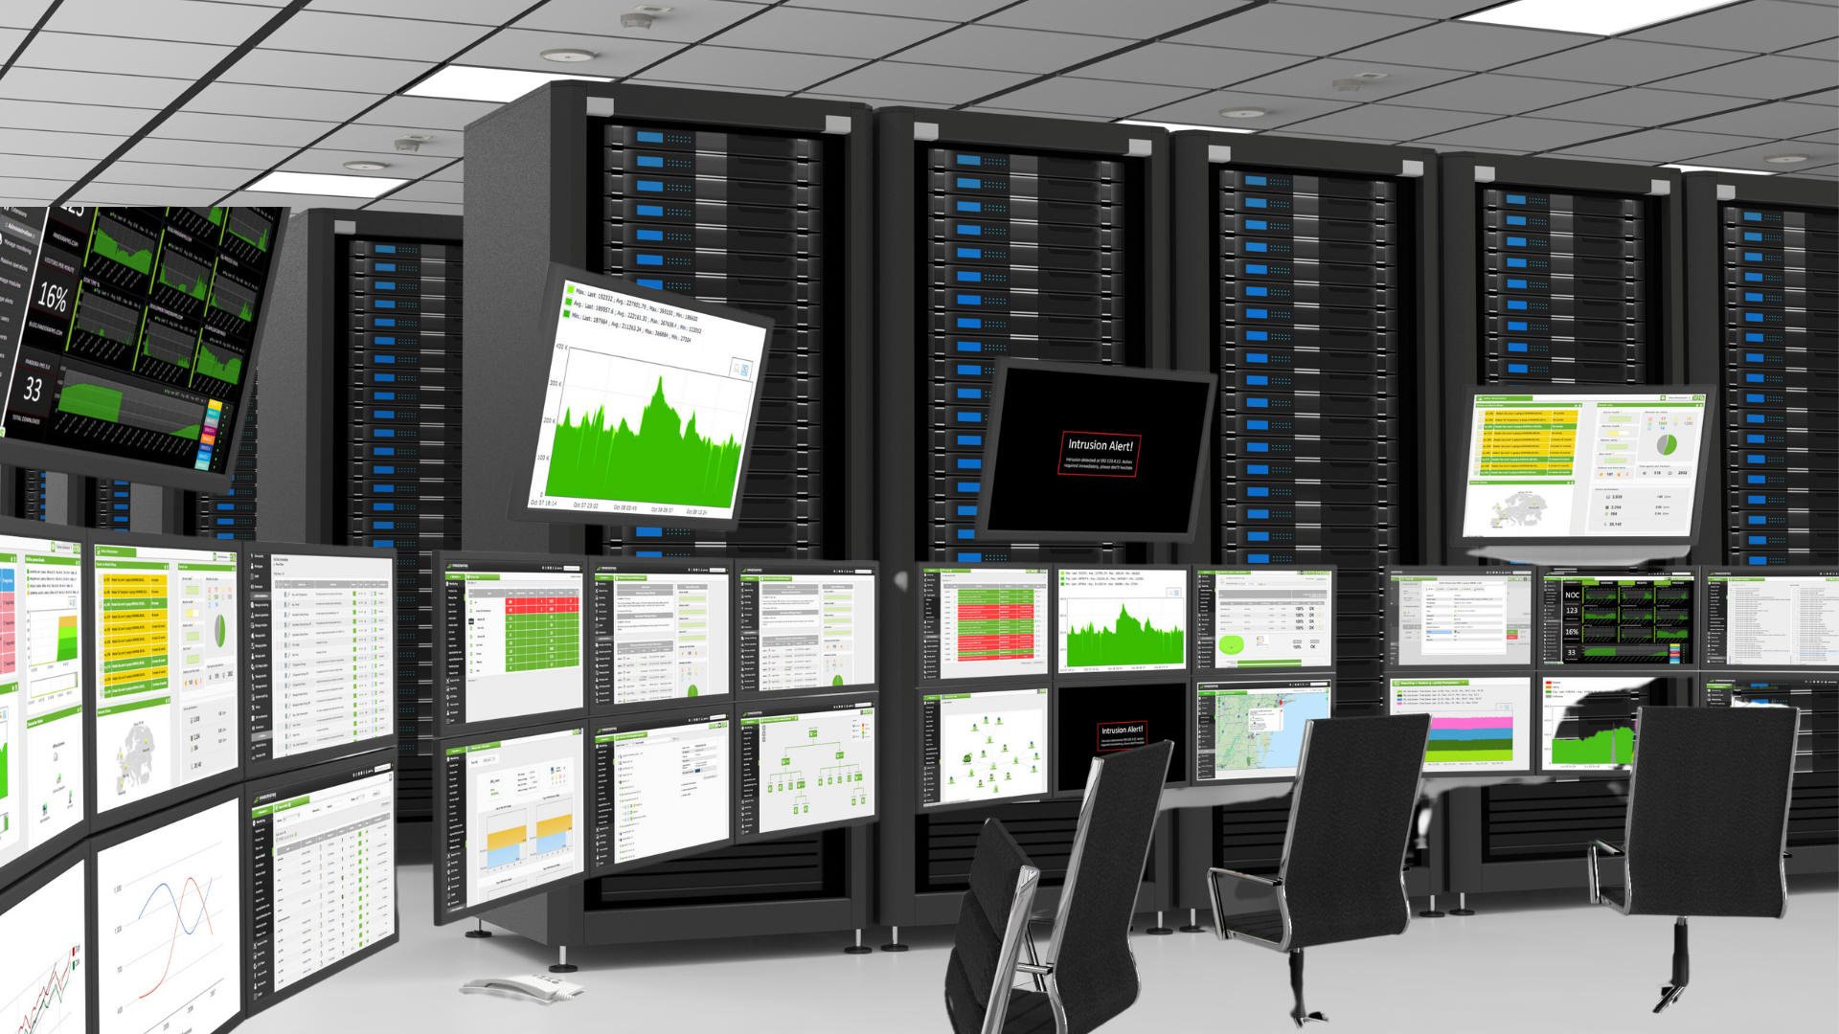
Data Center Monitoring System
Lakshmi Indrasena Reddy Bandi
614785086
Data Center Technician
Tamkang University

Slide 2
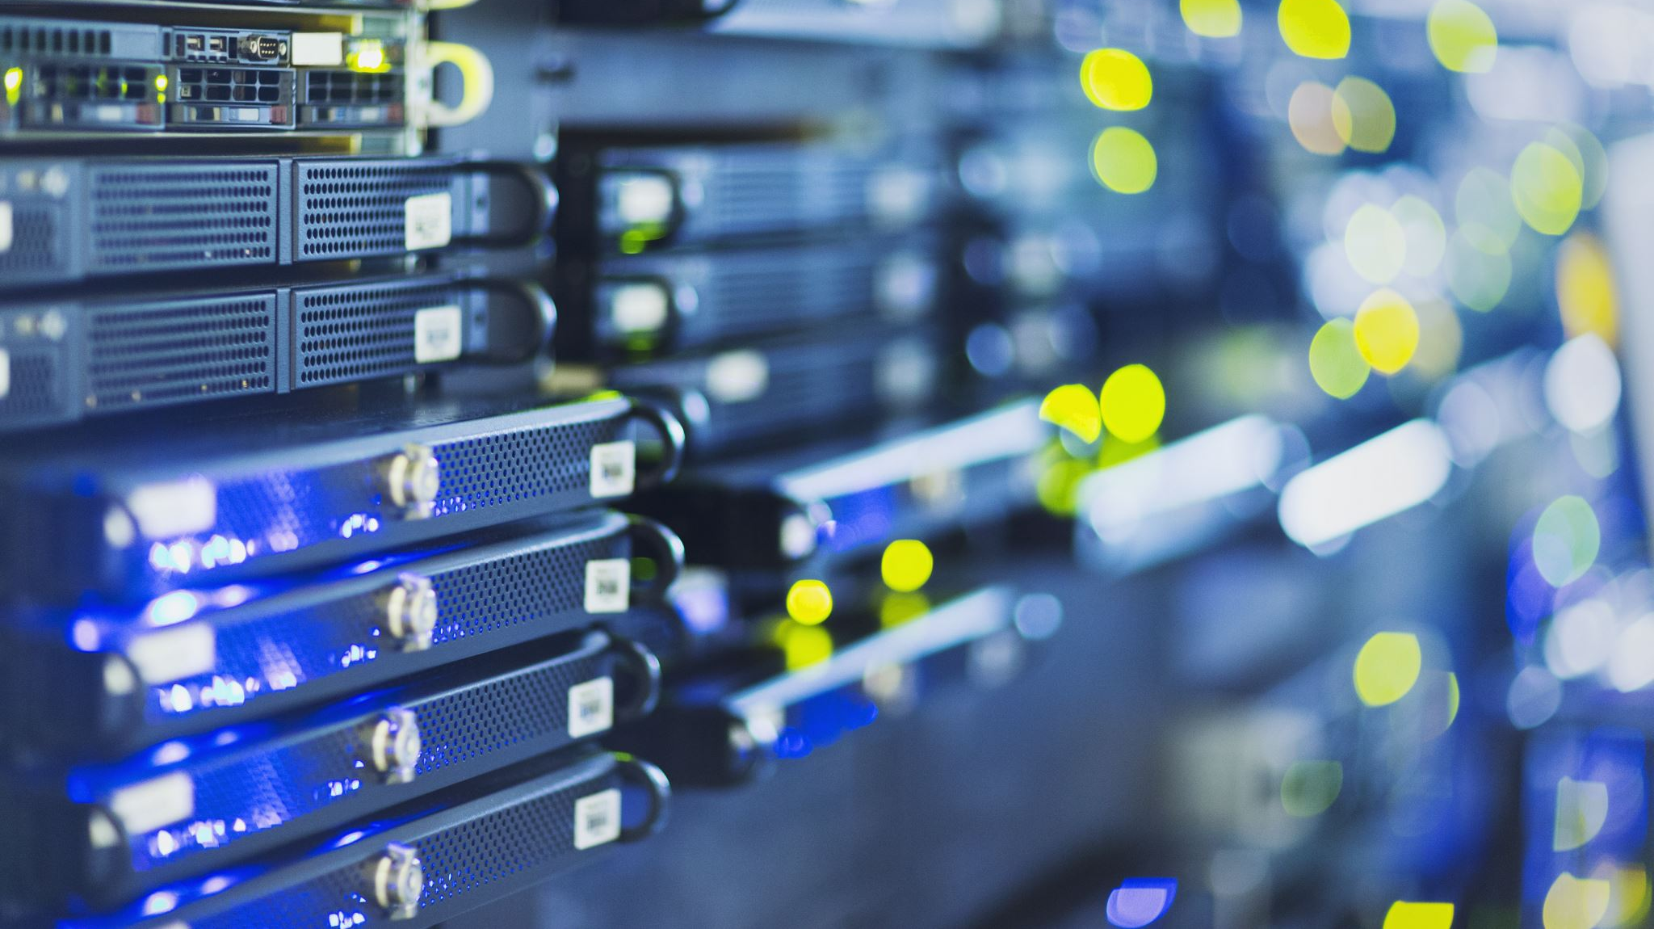
What is Data Center Monitoring System
A Data Center Monitoring System (DCMS) is a combination of hardware and software designed to track the health, performance, and environment of a data center in real time. It acts as the "nervous system" of the facility, ensuring that mission-critical servers and data remain safe and operational.

Slide 3
The Core Pillars of Monitoring
A comprehensive system doesn't just watch servers; it monitors four distinct areas:
IT Infrastructure: Tracks server health (CPU, RAM, storage), virtual machines (VMs), and application performance to prevent crashes.
Power & Energy: Monitors UPS (Uninterruptible Power Supply), PDUs (Power Distribution Units), and backup generators. It calculates PUE (Power Usage Effectiveness) to measure efficiency.
Environmental Conditions: Uses sensors to track temperature, humidity, airflow, and "liquid leaks" to prevent hardware damage from overheating or moisture.
Security (Physical & Cyber): Includes rack door sensors, CCTV, and biometric access logs, alongside digital monitoring for unauthorized network intrusions.

Slide 4
How the System Works
Data Collection: Physical sensors (thermal, humidity) and software protocols (SNMP, Modbus) gather raw data from every device.
Centralization: This data is sent to a DCIM (Data Center Infrastructure Management) software platform.
Visualization: Data is displayed on real-time dashboards (like the image I created for you) using 2D or 3D floor maps.
Alerting: If a metric crosses a "threshold" (e.g., a server rack gets too hot), the system sends instant alerts via SMS, email, or Slack.

Slide 5
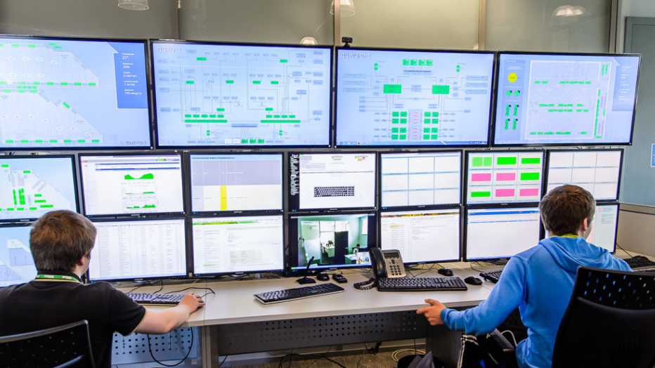
Tech Stacks
Python – Develop the website backed and SQL
Streamlit – framework host and display the web app
Pandas – Python framework
Sqlite – my database to store my report and system information
Pustil
GitHub – to store my project

Slide 6
System Design & Architecture
Admin:
Login to system or network
Accessing admin dashboard of the server or network
Configuration of the system and network
Managing all Networking information about GPU, CPU and Ping status
User:
Login to system
Accessing admin dashboard of the server or network
View and Download report and Test cases

Slide 7
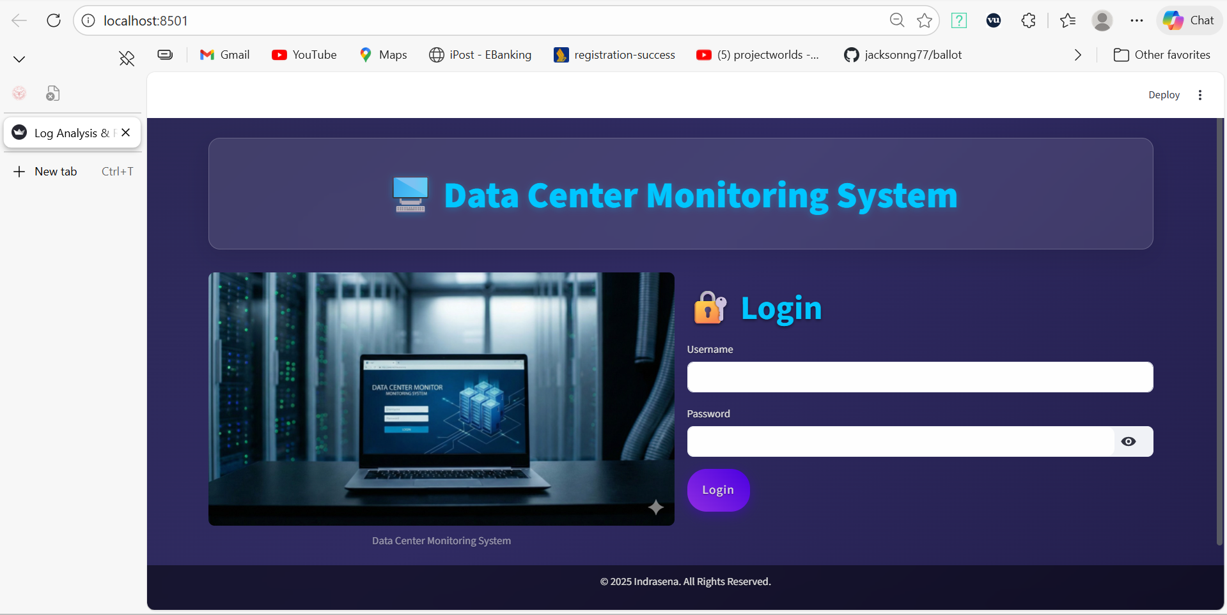
My final Project Data Center Monitoring System
Web App Front Page

Slide 8
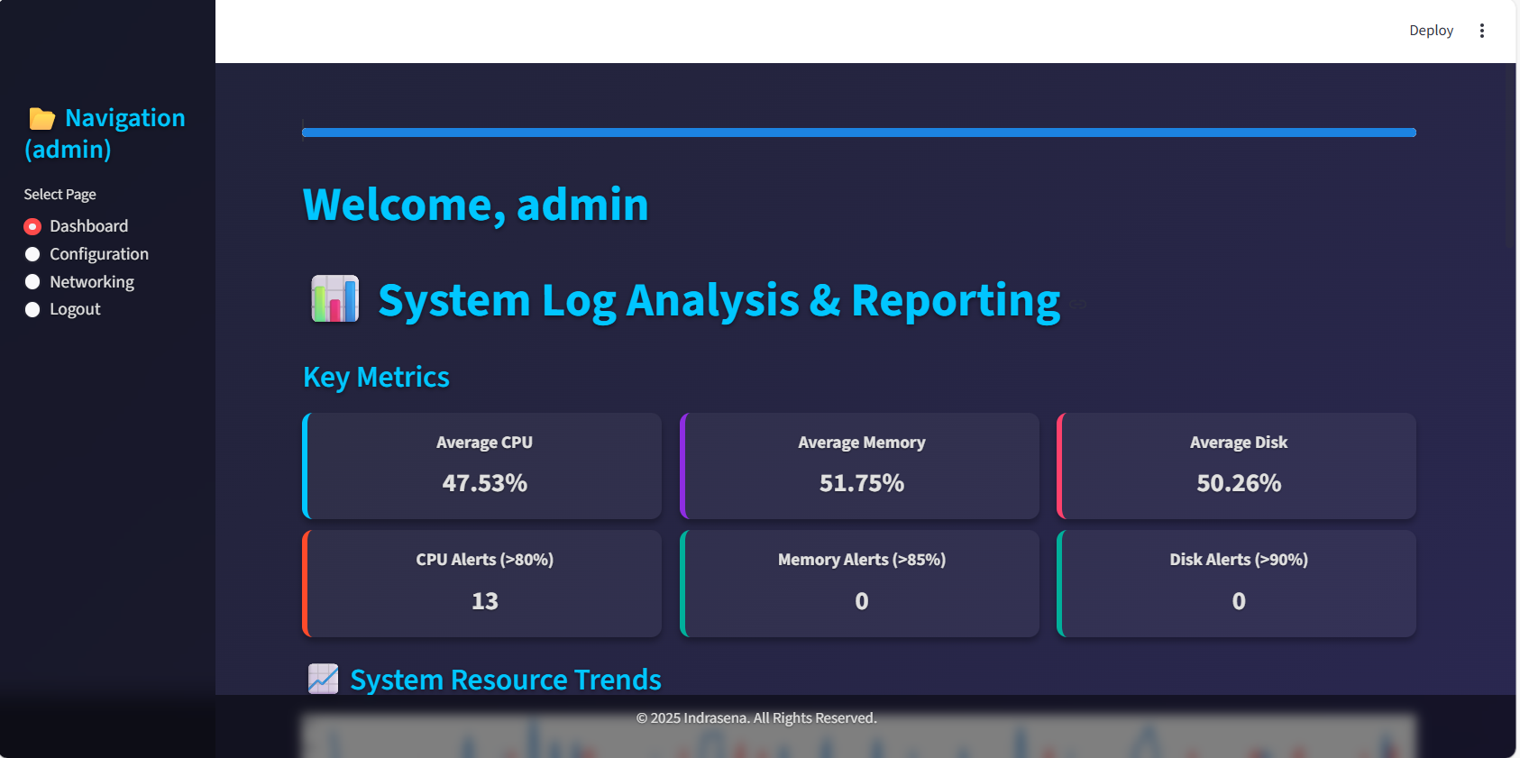
Admin Login View

Slide 9
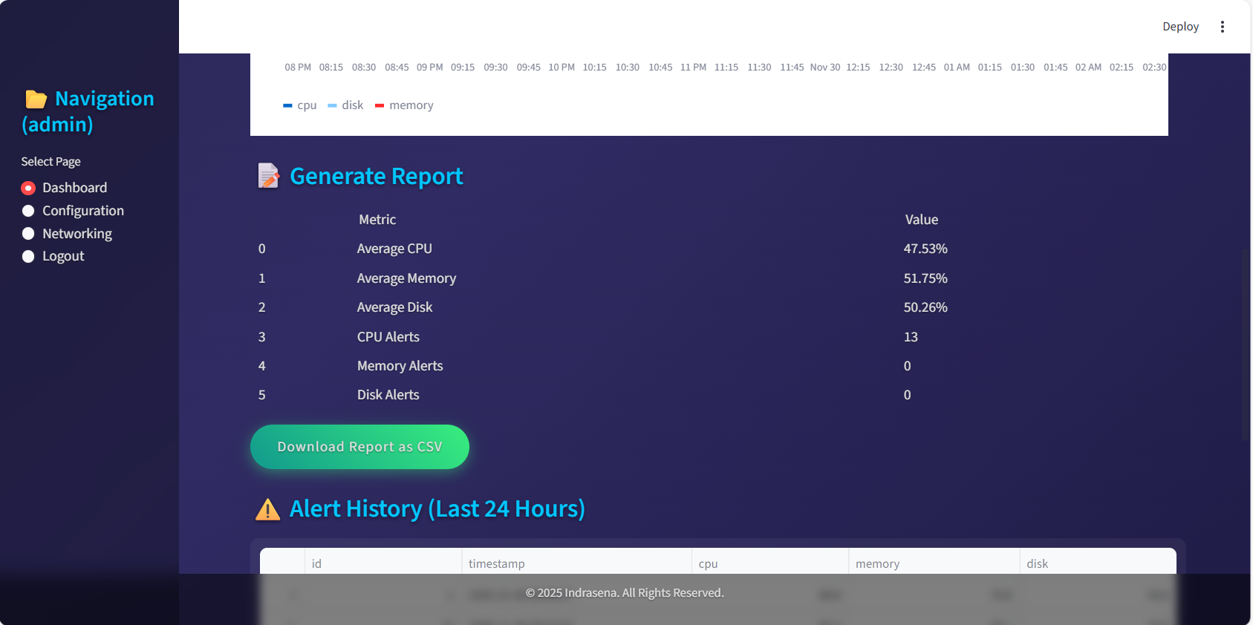
Generate Report

Slide 10
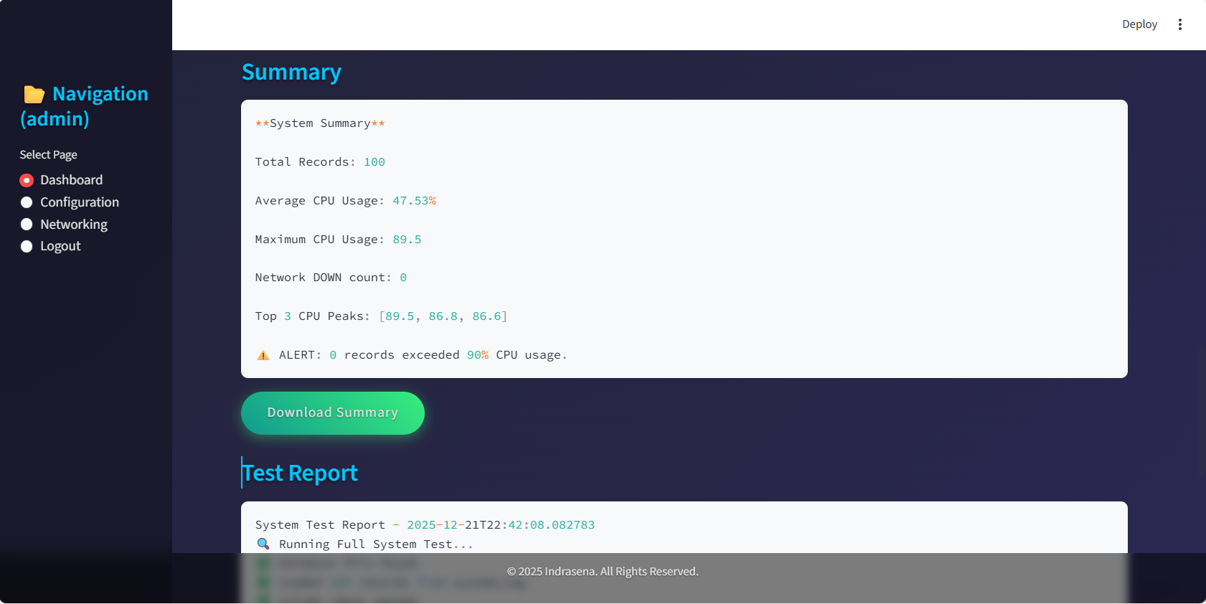
Summary and Test Report

Slide 11

Thank You
Let's move on to the presentation Demonstration of my Final Project.

